Slide 1

<Next Generation Networking for Virtual Reality and Game Player Collaborative and Multiplayer>
Team Members: <Bradley Marzouka, Gabriel Taveras> Product Owner: Dr. Francisco Ortega
Instructor: Masoud Sadjadi School of Computing and Information Sciences Florida International University
Final Presentation
<Spring 2017>
Notes:
7 seconds.( I will select 2 best slides (i will give them extra points and students will present for CIS committee)
Greet your audience, thank them for attending your presentation, introduce yourself, introduce your project, introduce your team members, and quickly indicate what each of you did in a high-level manner, and put more emphasis on your part/contribution.

Slide 2
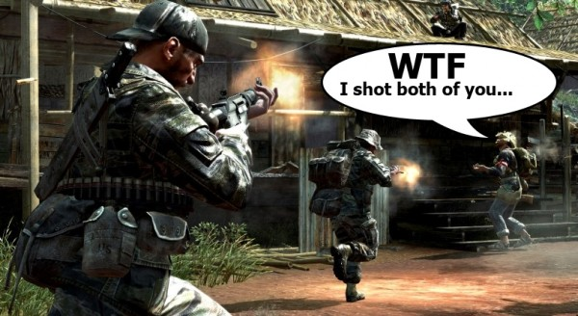
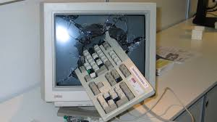


Project definition
Notes:
10 seconds.
Introduce the problem that the whole project (in all versions) tackles with GIF or screenshot.

Slide 3
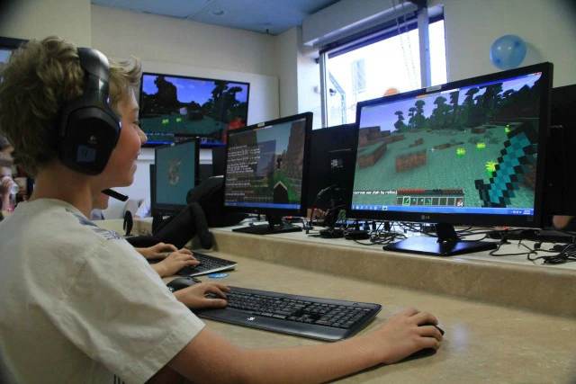

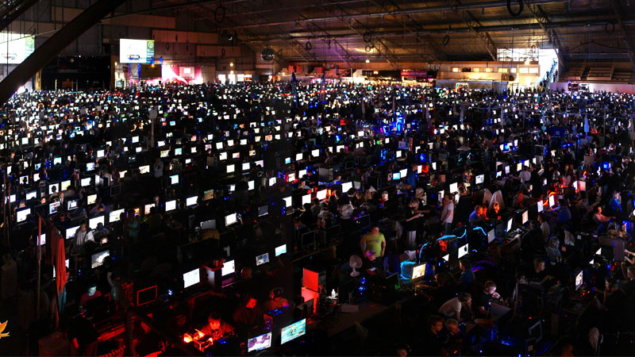
Project definition
Notes:
20 seconds.
Introduce the problem that the your project (in new version) tackles with GIF or screenshot.

Slide 4
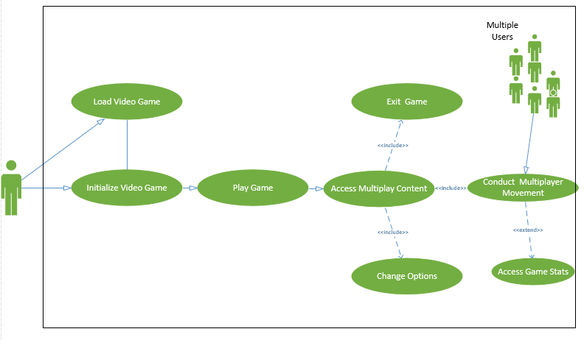
Requirements: Use Cases
Notes:
5 seconds
Show the Use Case Diagram for the whole project. Highlight your use cases.

Slide 5
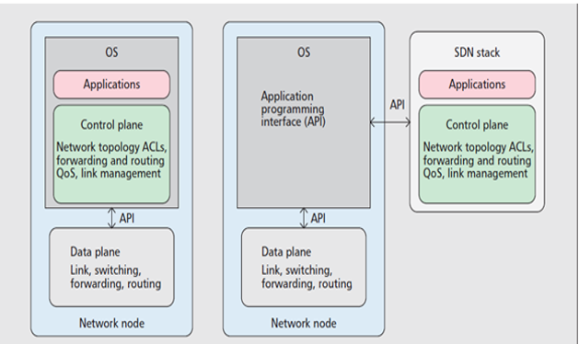
System Design: Architecture
Notes:
20 seconds
System design: Highlight the parts that you contributed to them.
1. System decomposition; identify the architecture patterns used
2. System deployment – h/w and s/w requirements

Slide 6
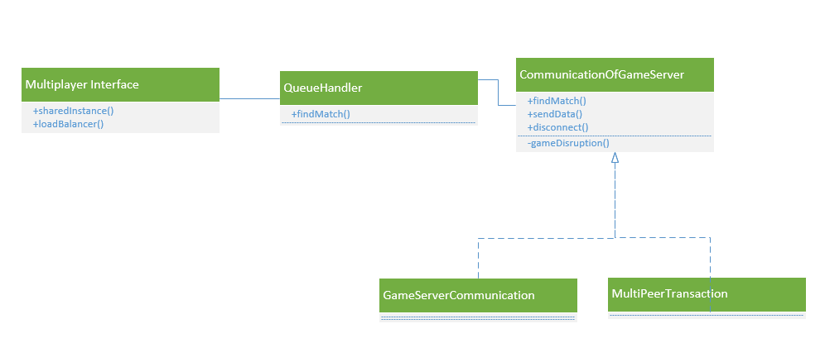
Minimal Class Diagram
Notes:
10 seconds.Minimal class diagram. Highlight the classes that you created/modified
Identify the design patterns used (one or more slides).

Slide 7
User Stories
As a gamer, I want to play multiplayer games that have as little latency as possible.
As a system administrator, I want to deploy a network that can keep user’s data secure.
As a gamer, I want to play multiplayer games that do not stutter or cut out.
As a system administrator, I want to deploy a network that is easy to maintain.
As a system administrator, I want to deploy a network that is capable of supporting VR/AR gaming.
Notes:
5 seconds.
List the user stories that you worked on them.(put in order of importance). Stay focused on the parts that you have been working.

Slide 8
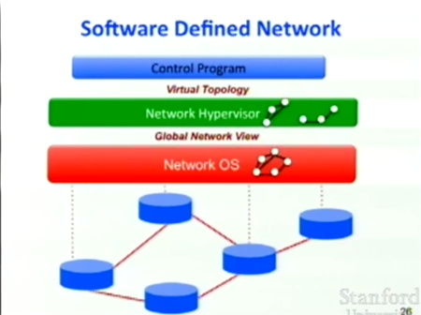
User Story #1
As a gamer, I want to play multiplayer games that have as little latency as possible.
An SDN network is most important in completing this task due to its capability of supporting high bandwidth loads and low latency communication.
Notes:
60 seconds
The tile of user story
The most important user story you worked on it. You have to describe this one very well and be proud of that.
Please present and show the complexity of your work, code, algorithms, and technical challenges and technologies you have used. (you could use screenshot if you want. Visual presentations are better than text presentation)
Go into the details of the most important/significant tasks using bullet lists or visual graphs or state chart diagram
Sequence Diagram for this user story is mandatory (in another separate page if required)
Demo using screenshots or GIF (in another separate page if required)

Slide 9
User Story #2
As a system administrator, I want to deploy a network that can keep user’s data secure.
Using an SDN network along with OpenFlow and various other protocols such as FortNOX, we can secure the network and prevent different kinds of attacks on the network.
Some examples of attacks are DoS attacks, application layer attacks, controller attacks, or flow table overloads.
Notes:
20 seconds
The tile of user story
Please present and show the complexity of your work, code, algorithms, and technical challenges and technologies you have used. (you could use screenshot if you want. Visual presentations are better than text presentation) - Go into the details of the most important/significant tasks using bullet lists or visual graphs or state chart diagram - Demo using screenshots or GIF (in another separate page if required)
Sequence Diagram for this user story is optional

Slide 10
User Story #3
As a gamer, I want to play multiplayer games that do not stutter or cut out.
When current networks cannot output the required amount of bandwidth network resources become unavailable. This can lead to stuttering and dropped connections, problems that are very annoying to fast-paced gaming.
Notes:
20 seconds
The tile of user story
Please present and show the complexity of your work, code, algorithms, and technical challenges and technologies you have used. (you could use screenshot if you want. Visual presentations are better than text presentation) - Go into the details of the most important/significant tasks using bullet lists or visual graphs or state chart diagram - Demo using screenshots or GIF (in another separate page if required)
Sequence Diagram for this user story is optional

Slide 11
User Story #4
As a system administrator, I want to deploy a network that is easy to maintain.
To reduce the complexity of any issues that may arise in the future on the network, it becomes an advantage to have the network controlled by one location.
This central location, however, makes it a primary target of black-hat hackers looking for personal data.
Notes:
20 seconds
The tile of user story
Please present and show the complexity of your work, code, algorithms, and technical challenges and technologies you have used. (you could use screenshot if you want. Visual presentations are better than text presentation) - Go into the details of the most important/significant tasks using bullet lists or visual graphs or state chart diagram - Demo using screenshots or GIF (in another separate page if required)
Sequence Diagram for this user story is optional

Slide 12
User Story #5
As a system administrator, I want to deploy a network that is capable of supporting VR/AR gaming.
One of the requirements of creating a new network design is its ability to handle not only current bandwidth load needs, but also to be able to upscale easily to support the technologies of the future.
Notes:
20 seconds
The tile of user story
Please present and show the complexity of your work, code, algorithms, and technical challenges and technologies you have used. (you could use screenshot if you want. Visual presentations are better than text presentation) - Go into the details of the most important/significant tasks using bullet lists or visual graphs or state chart diagram - Demo using screenshots or GIF (in another separate page if required)
Sequence Diagram for this user story is optional

Slide 13
Test Suites and Test Cases
We want to provide a foundational support for future implementation for multiplayer collaboration. In future projects, we aim to test SDN on higher end gaming platforms to test, and improve network efficiency in an online environment.
Notes:
10 seconds
A description of verification process and Test Suites and Test Cases for one of the use cases.
1 One sunny day and one rainy day for the implemented use cases (one or more slides).
2 Automated test scripts for the implemented use cases (if any) (one or more slides).

Slide 14




Summary
Gabriel Taveras - Latency
Bradley Marzouka - Cyber security
Gabriel Taveras - gtave006@fiu.edu
Bradley Marzouka - bmarz001@fiu.edu
Questions?
Notes:
10 seconds
Summarize your contribution, mention your effort for Scrum, Mingle, Github, Google Drive Documentation and minutes
Include your contact information
Ask if anyone has any questions for you.
Thank your audience

